Slide 1
Data Analysis Project NYC 311 Service (Jan -Jun17) CIS 9655 – Fall 2018
Gina Moreno
Yifan Yang
Shobhit Ratan

Slide 2
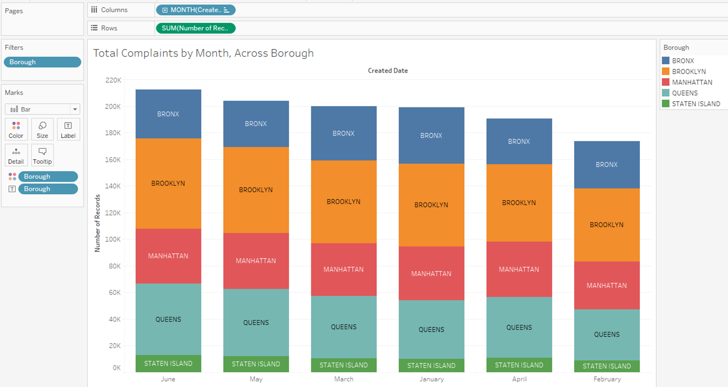
Question 1: Which month had the greatest total number of complaints, for the first half of 2017?

Slide 3
Question 1: Which month had the greatest total number of complaints, for the first half of 2017?
Key Insights
June had the greatest number of complaints followed by May
February had the fewest complaints
We can speculate as to why this might be – seasonal variation
Visually encoding borough with color we can see quite easily that Brooklyn had the greatest number of complaints overall for the time period we looked at

Slide 4
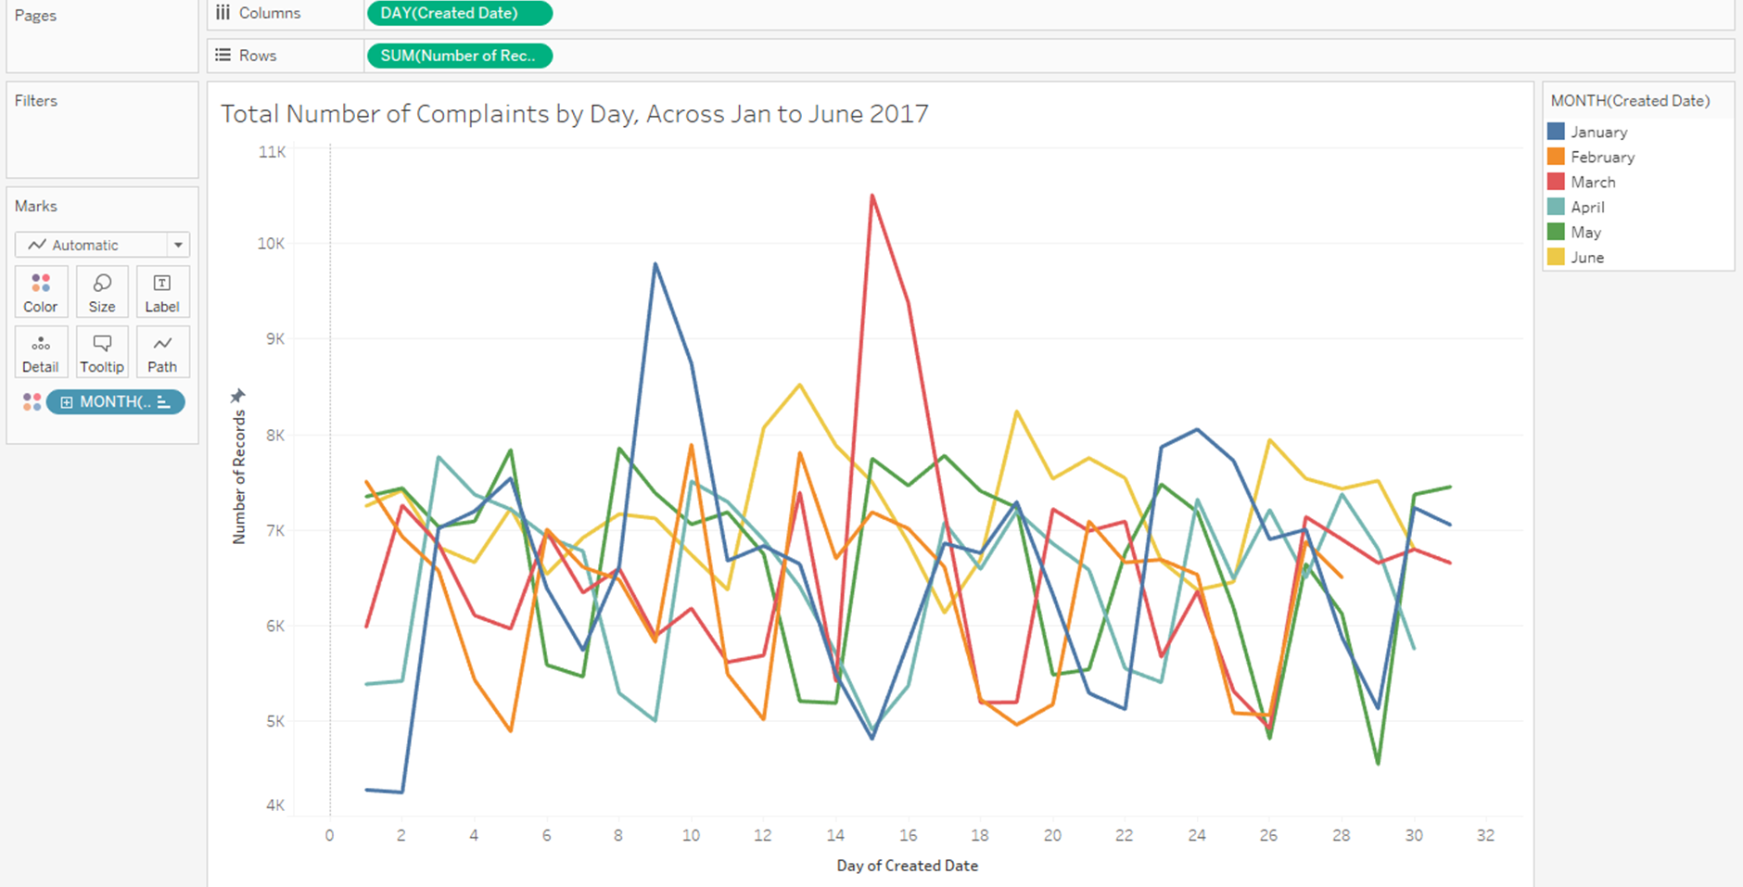
Question 2: Which day of which month had the greatest number of complaints?

Slide 5
Question 2: Which day of which month had the greatest number of complaints?
Key Insights
Visually encoding month using color allows us to see this while the horizontal axis encodes the ordered variable of day
March 15th had the most number of complaints
January 2nd had the fewest number of complaints
Again, we are encouraged to speculate why this might be the case

Slide 6
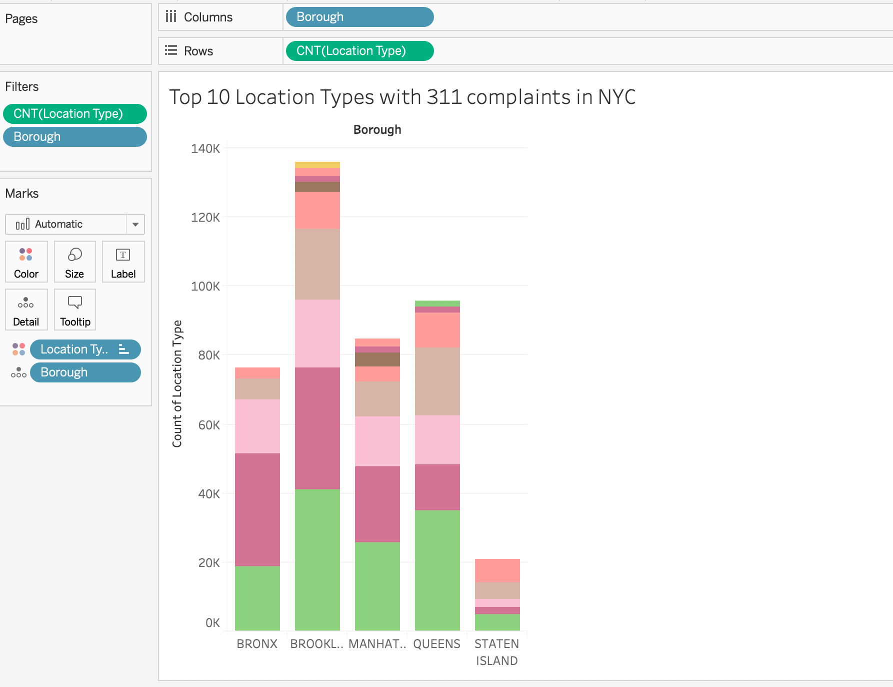
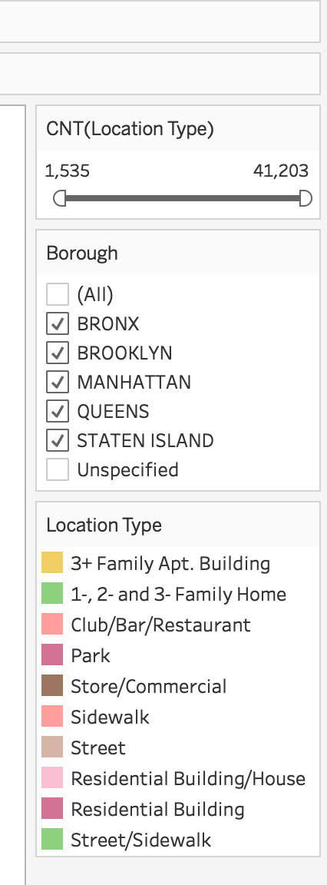
Question 4: What are the top 10 location types where 311 complaints occurred across the 5 boroughs?

Slide 7
Question 4: What are the top 10 location types where 311 complaints occurred across the 5 boroughs?
Key Insights
Street/sidewalk is the location type which had most 311 complaints.
Residential buildings are the second top location with most 311 complaints.
In terms of variety of location types, Brooklyn and Queens have more different location types than other boroughs.
Brooklyn has more location types than other 4 boroughs.

Slide 8
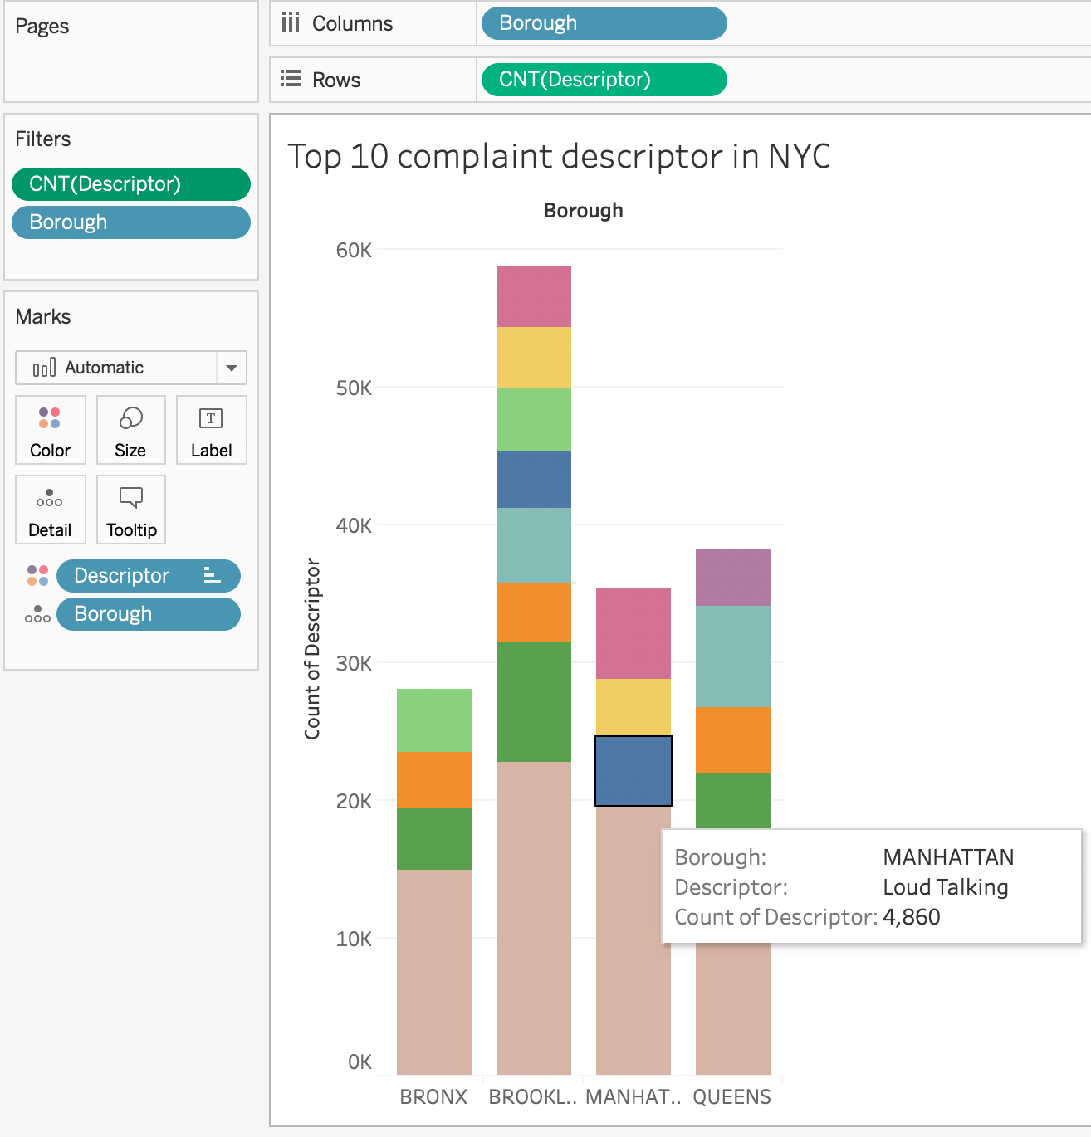
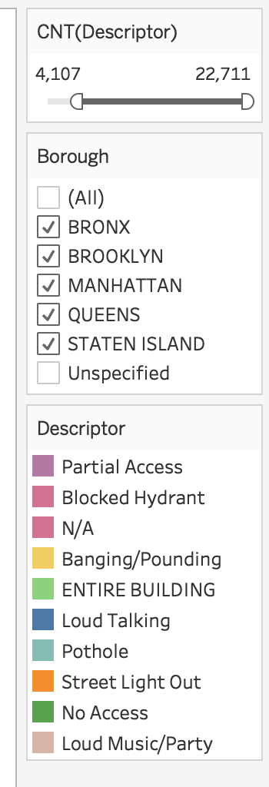
Question 5: What are the top 10 noise complaint descriptors across the 5 boroughs?

Slide 9
Question 5: What are the top 10 noise complaint descriptors across the 5 Boroughs?
Key Insights
Loud music is the top complaint descriptor.
No access is the second top complaint descriptor.
In terms of variety of complaint descriptors, Brooklyn and Queens have more different complaint descriptors than other boroughs.
Brooklyn has most complaint descriptors than other 4 boroughs.

Slide 10
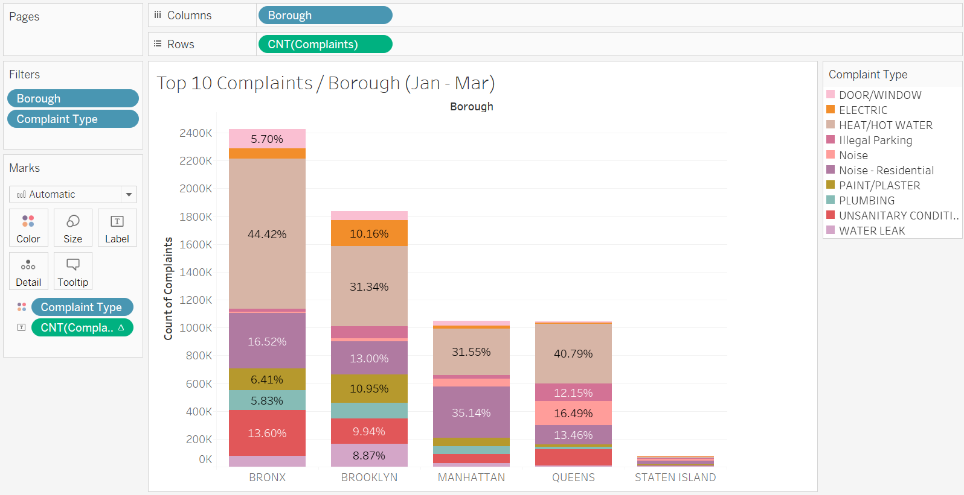
Question 6: What are the top 10 complaint types in Q1(2017) across the 5 boroughs?

Slide 11
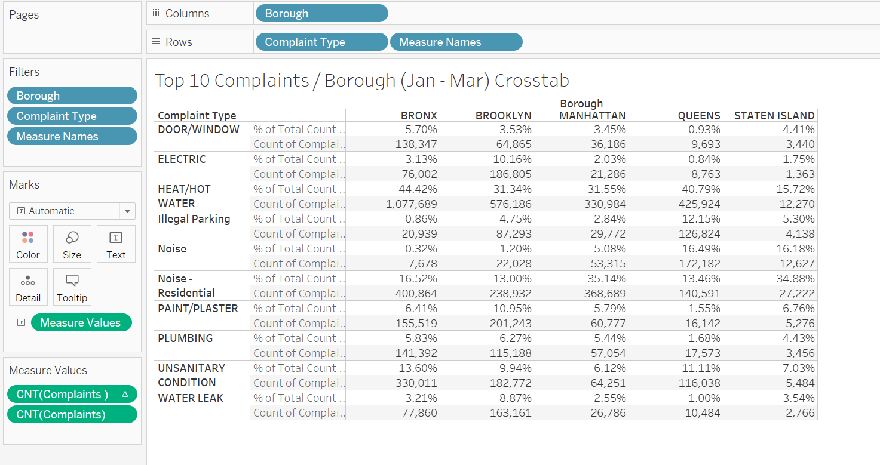
Question 6: What are the top 10 complaint types in Q1 (2017) across the 5 Boroughs?

Slide 12
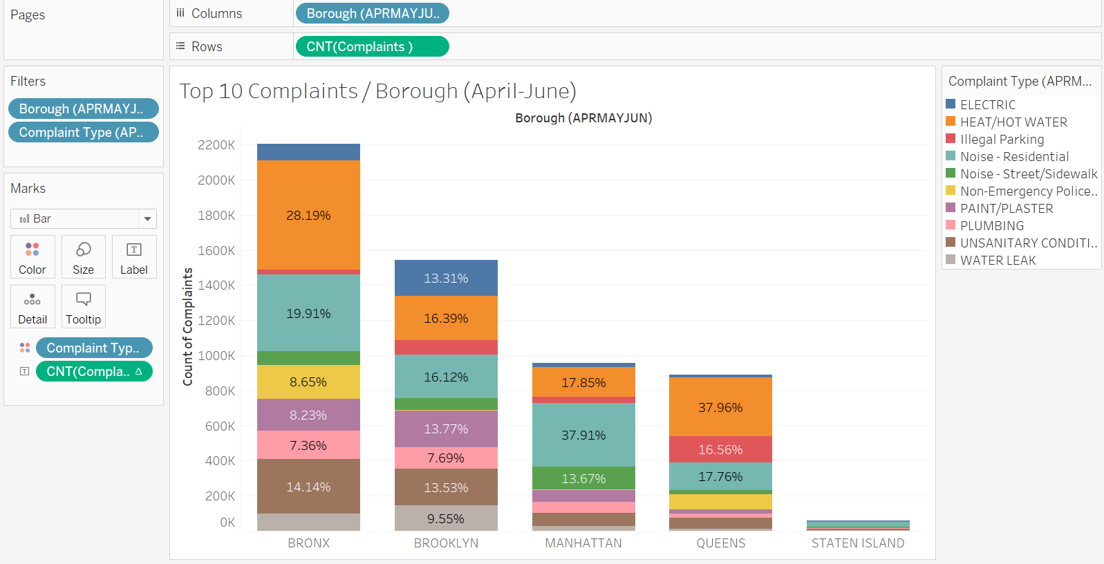
Question 6: What are the top 10 complaint types in Q2(2017) across the 5 Boroughs?

Slide 13
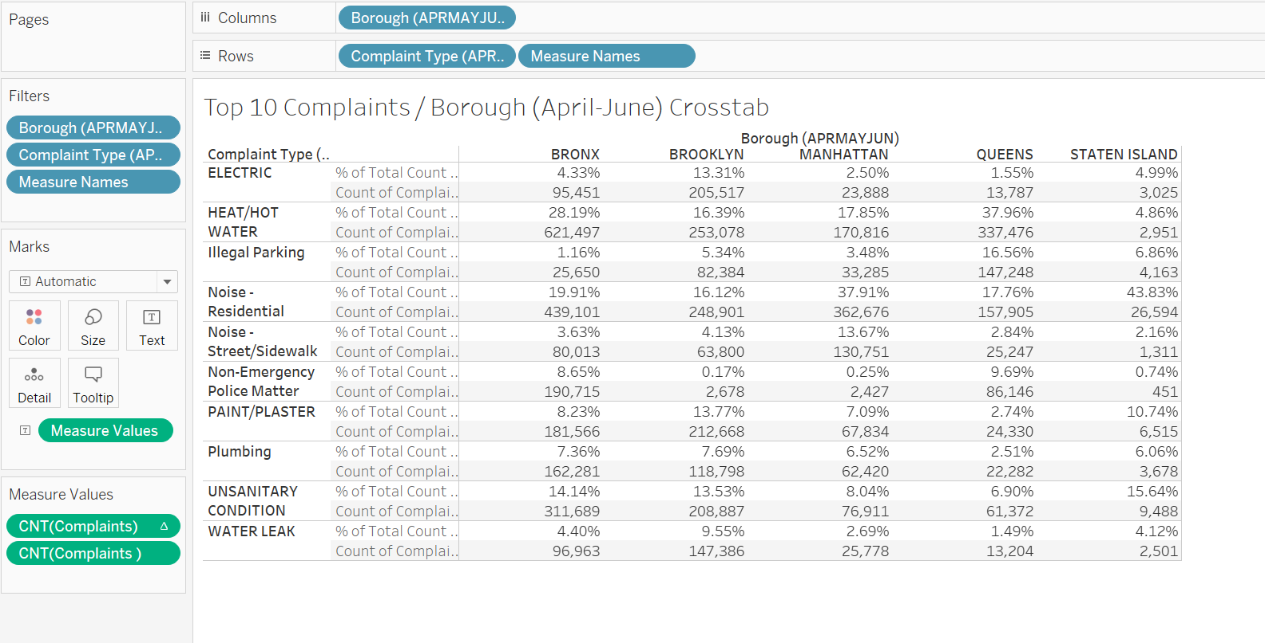
Question 6: What are the top 10 complaint types in Q2(2017) across the 5 Boroughs?

Slide 14
Question 6: What are the top 10 complaint types per quarter (Q1 & Q2) across the 5 Boroughs?
Key Insights
In both quarters (Q1 & Q2), heat/hot water is the biggest complaint type for 3 of the 5 Boroughs (Brooklyn, Bronx and Queens). However, for all boroughs the percentage of this complaint type reduces in Q2(Apr - Jun).
In Manhattan and Staten Island, Residential Noise complaint type tops for both quarters. However, for all Boroughs, the percentage of this complaint type increased in Q2 compared to Q1.
Data visualization encodings may be used by service providers / agencies to "what are the major complaints" and then further investigate; "why these complaints are dominant in specific Boroughs?

Slide 15
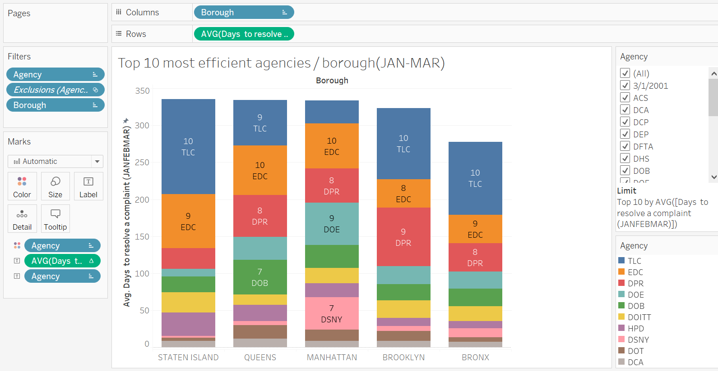
Question 7: Which agency is the most efficient (in Q1) to resolve a complaint across the 5 Boroughs?

Slide 16
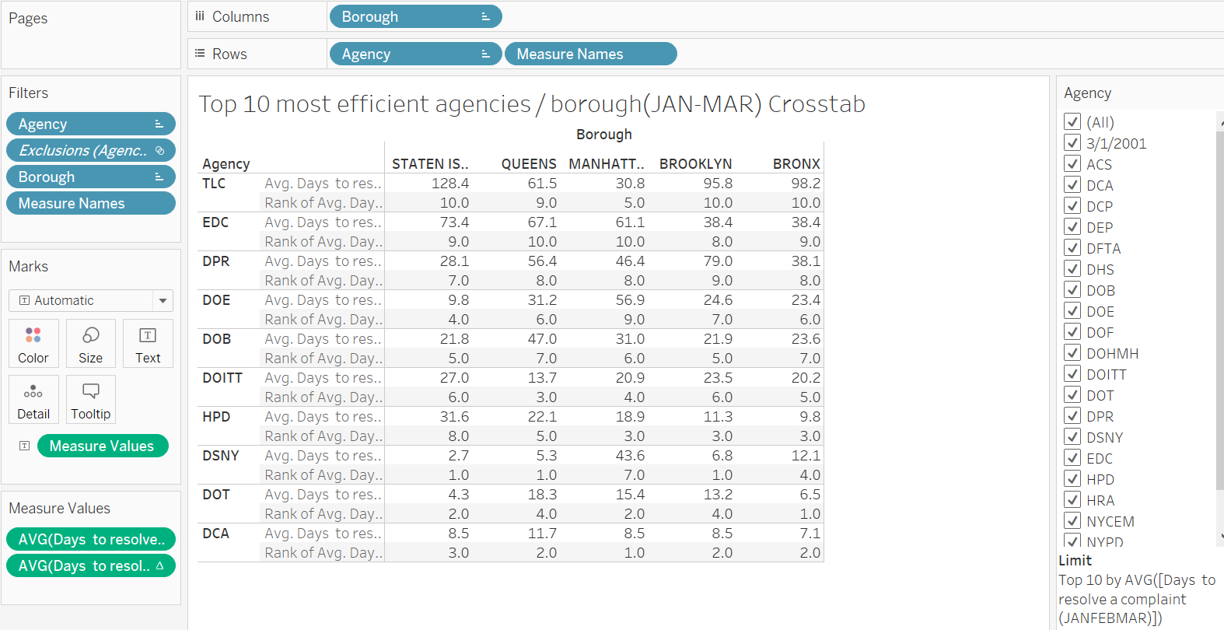
Question 7: Which agency is the most efficient (in Q1) to resolve a complaint across the 5 Boroughs?

Slide 17
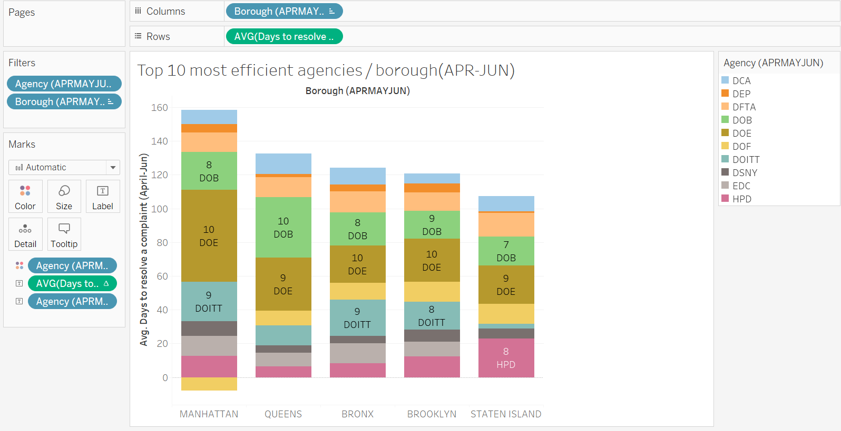
Question 7: Which agency is the most efficient (in Q2) to resolve a complaint across the 5 Boroughs?

Slide 18
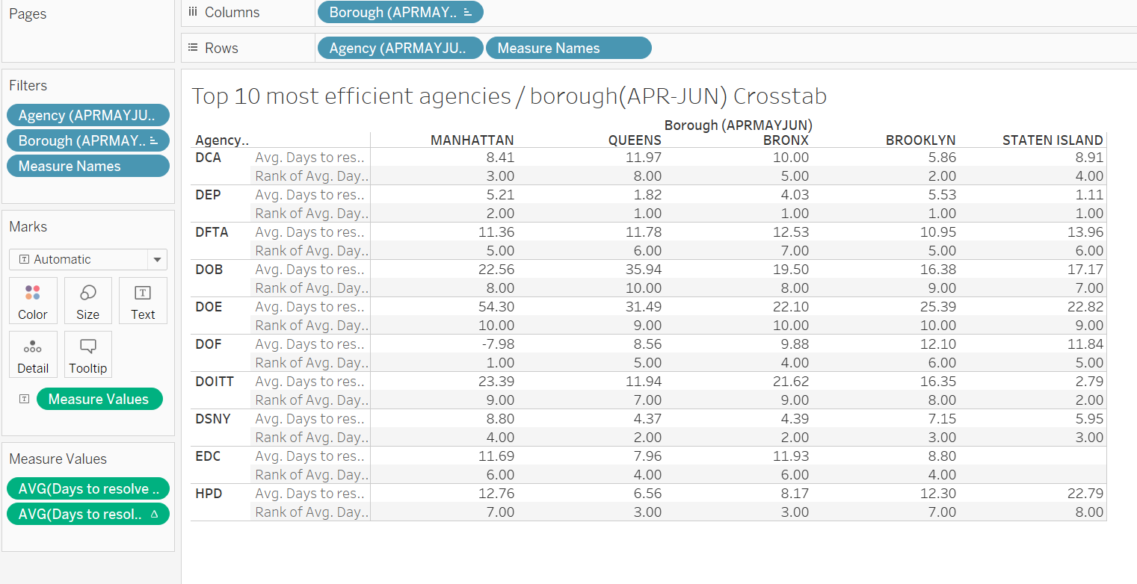
Question 7: Which agency is the most efficient (in Q2) to resolve a complaint across the 5 Boroughs?

Slide 19
Question 7: Which agency is the most efficient per quarter (Q1 & Q2) to resolve a complaint across the 5 Boroughs?
Key Insights
In Q1 (Jan – Mar), Department of Sanitation (DSNY) is the most efficient agency in 3 of the 5 Boroughs (Staten Island, Queens & Brooklyn). DCA is most efficient in Manhattan and DOT in Bronx.
In Q2 (Apr – Jun), Department of Environmental Protection(DEP) is the most efficient agency in all Boroughs except Manhattan. DOF is top ranked in Manhattan. DEP did not even figure in the top 10 in Q1. Hence, for better insight, this may be further investigated.
DSNY continues to be among top performing agency for all Boroughs in Q2.
In Q2, Staten Island has missing information for Economic Development Corporation (EDC). May need further investigation.

Slide 20
